Slide 1
Chapter 5
Classical linear regression model assumptions and diagnostics
‘Introductory Econometrics for Finance’ © Chris Brooks 2019
Notes:
Introductory Econometrics for Finance
Copyright 2002, Chris Brooks

Slide 2
Violation of the Assumptions of the CLRM
Recall that we assumed of the CLRM disturbance terms:
1. E(u_{t}) = 0
2. Var(u_{t}) = σ² < ∞
3. Cov (u_{i},u_{j}) = 0
4. The X matrix is non-stochastic or fixed in repeated samples
5. u_{t} ∼ N(0,σ²)
‘Introductory Econometrics for Finance’ © Chris Brooks 2019

Slide 3
Investigating Violations of the
Assumptions of the CLRM
We will now study these assumptions further, and in particular look at:
- How we test for violations
- Causes
- Consequences
in general we could encounter any combination of 3 problems:
- the coefficient estimates are wrong
- the associated standard errors are wrong
- the distribution that we assumed for the
test statistics will be inappropriate
- Solutions
- the assumptions are no longer violated
- we work around the problem so that we
use alternative techniques which are still valid
‘Introductory Econometrics for Finance’ © Chris Brooks 2019
Notes:
Introductory Econometrics for Finance
Copyright 2002, Chris Brooks

Slide 4
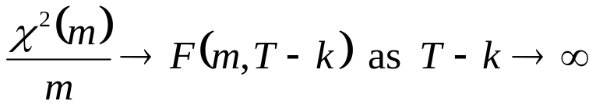
Statistical Distributions for Diagnostic Tests
Often, an F- and a χ²- version of the test are available.
The F-test version involves estimating a restricted and an unrestricted version of a test regression and comparing the RSS.
The χ²- version is sometimes called an “LM” test, and only has one degree of freedom parameter: the number of restrictions being tested, m.
Asymptotically, the 2 tests are equivalent since the χ² is a special case of the F-distribution:
For small samples, the F-version is preferable.
‘Introductory Econometrics for Finance’ © Chris Brooks 2019
Notes:
Introductory Econometrics for Finance
Copyright 2002, Chris Brooks

Slide 5
Assumption 1: E(u_{t}) = 0
Assumption that the mean of the disturbances is zero.
For all diagnostic tests, we cannot observe the disturbances and so perform the tests of the residuals.
The mean of the residuals will always be zero provided that there is a constant term in the regression.
‘Introductory Econometrics for Finance’ © Chris Brooks 2019

Slide 6
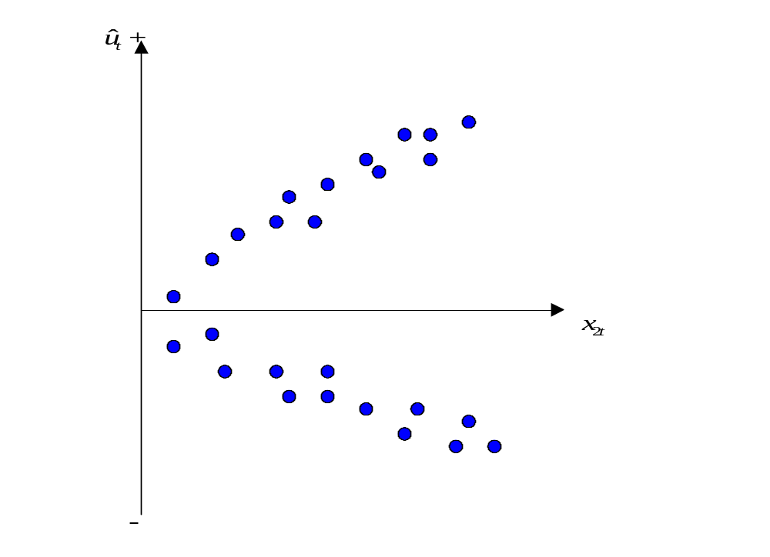

Assumption 2: Var(u_{t}) = σ² < ∞
We have so far assumed that the variance of the errors is constant, σ² - this is known as homoscedasticity.
If the errors do not have a
constant variance, we say
that they are heteroscedastic
e.g. say we estimate a regression
and calculate the residuals, .
‘Introductory Econometrics for Finance’ © Chris Brooks 2019
Notes:
Introductory Econometrics for Finance
Copyright 2002, Chris Brooks

Slide 7

Detection of Heteroscedasticity: The GQ Test
Graphical methods
Formal tests: There are many of them: we will discuss Goldfeld-Quandt test and White’s test
The Goldfeld-Quandt (GQ) test is carried out as follows.
Split the total sample of length T into two sub-samples of length T₁ and T₂. The regression model is estimated on each sub-sample and the two residual variances are calculated.
The null hypothesis is that the variances of the disturbances are equal,
H₀:
‘Introductory Econometrics for Finance’ © Chris Brooks 2019
Notes:
Introductory Econometrics for Finance
Copyright 2002, Chris Brooks

Slide 8
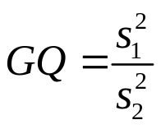
The GQ Test (Cont’d)
3. The test statistic, denoted GQ, is simply the ratio of the two residual variances where the larger of the two variances must be placed in the numerator
4. The test statistic is distributed as an F(T₁-k, T₂-k) under the null of homoscedasticity
5. A problem with the test is that the choice of where to split the sample is that usually arbitrary and may crucially affect the outcome of the test
‘Introductory Econometrics for Finance’ © Chris Brooks 2019
Notes:
Introductory Econometrics for Finance
Copyright 2002, Chris Brooks

Slide 9
Detection of Heteroscedasticity using White’s Test
White’s general test for heteroscedasticity is one of the best approaches because it makes few assumptions about the form of the heteroscedasticity.
The test is carried out as follows.
1. Assume that the regression we carried out is:
y_{t} = β₁ + β₂x_{2t} + β₃x_{3t} + u_{t}
And we want to test Var(u_{t}) = σ². We estimate the model, obtaining the residuals,
2. Then run the auxiliary regression
‘Introductory Econometrics for Finance’ © Chris Brooks 2019
Notes:
Introductory Econometrics for Finance
Copyright 2002, Chris Brooks

Slide 10
Performing White’s Test for Heteroscedasticity
3. Obtain R² from the auxiliary regression and multiply it by the number of observations, T. It can be shown that
T R² ∼ χ² (m)
where m is the number of regressors in the auxiliary regression excluding the constant term.
4. If the χ² test statistic from step 3 is greater than the corresponding value from the statistical table then reject the null hypothesis that the disturbances are homoscedastic.
‘Introductory Econometrics for Finance’ © Chris Brooks 2019

Slide 11
Consequences of Using OLS in the Presence of Heteroscedasticity
OLS estimation still gives unbiased coefficient estimates, but they are no longer BLUE.
This implies that if we still use OLS in the presence of heteroscedasticity, our standard errors could be inappropriate and hence any inferences we make could be misleading.
Whether the standard errors calculated using the usual formulae are too big or too small will depend upon the form of the heteroscedasticity.
‘Introductory Econometrics for Finance’ © Chris Brooks 2019

Slide 12

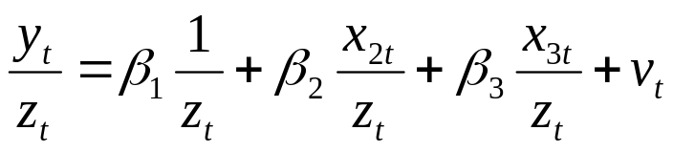
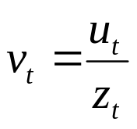
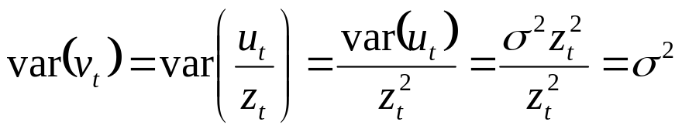
How Do we Deal with Heteroscedasticity?
If the form (i.e. the cause) of the heteroscedasticity is known, then we can use an estimation method which takes this into account (called generalised least squares, GLS).
A simple illustration of GLS is as follows: Suppose that the error variance is related to another variable z_{t} by
To remove the heteroscedasticity, divide the regression equation by z_{t}
where is an error term.
Now for known z_{t}.
‘Introductory Econometrics for Finance’ © Chris Brooks 2019
Notes:
Introductory Econometrics for Finance
Copyright 2002, Chris Brooks

Slide 13
Other Approaches to Dealing with Heteroscedasticity
So the disturbances from the new regression equation will be homoscedastic.
Other solutions include:
1. Transforming the variables into logs or reducing by some other measure of “size”.
2. Use White’s heteroscedasticity consistent standard error estimates.
The effect of using White’s correction is that in general the standard errors for the slope coefficients are increased relative to the usual OLS standard errors.
This makes us more “conservative” in hypothesis testing, so that we would need more evidence against the null hypothesis before we would reject it.
‘Introductory Econometrics for Finance’ © Chris Brooks 2019
Notes:
Introductory Econometrics for Finance
Copyright 2002, Chris Brooks

Slide 14
Background –
The Concept of a Lagged Value
t y_{t} y_{t-1} Δy_{t}
1989M09 0.8 - -
1989M10 1.3 0.8 1.3-0.8=0.5
1989M11 -0.9 1.3 -0.9-1.3=-2.2
1989M12 0.2 -0.9 0.2--0.9=1.1
1990M01 -1.7 0.2 -1.7-0.2=-1.9
1990M02 2.3 -1.7 2.3--1.7=4.0
1990M03 0.1 2.3 0.1-2.3=-2.2
1990M04 0.0 0.1 0.0-0.1=-0.1
  . . . .
  . . . .
  . . . .
‘Introductory Econometrics for Finance’ © Chris Brooks 2019
Notes:
Introductory Econometrics for Finance
Copyright 2002, Chris Brooks

Slide 15

Autocorrelation
We assumed of the CLRM’s errors that Cov (u_{i} , u_{j}) = 0 for i≠j, i.e.
This is essentially the same as saying there is no pattern in the errors.
Obviously we never have the actual u’s, so we use their sample counterpart, the residuals (the ’s).
If there are patterns in the residuals from a model, we say that they are autocorrelated.
Some stereotypical patterns we may find in the residuals are given on the next 3 slides.
‘Introductory Econometrics for Finance’ © Chris Brooks 2019
Notes:
Introductory Econometrics for Finance
Copyright 2002, Chris Brooks

Slide 16
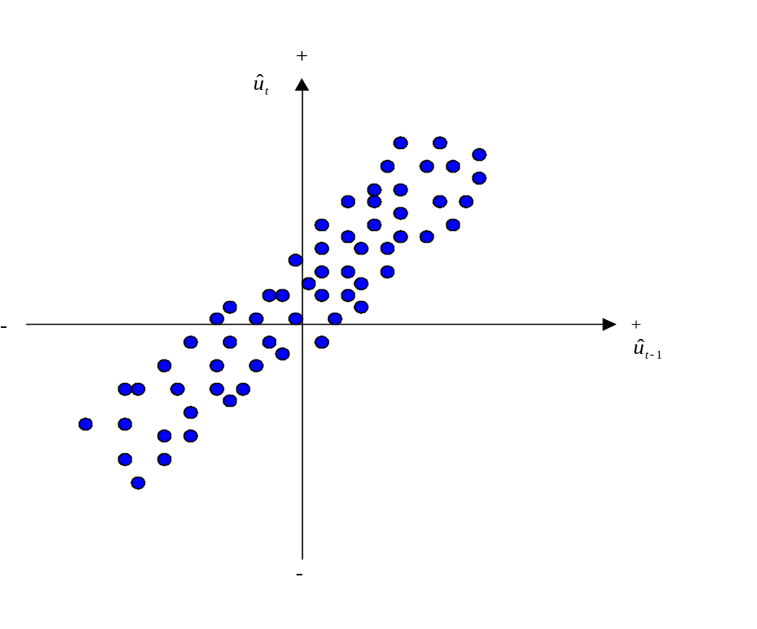
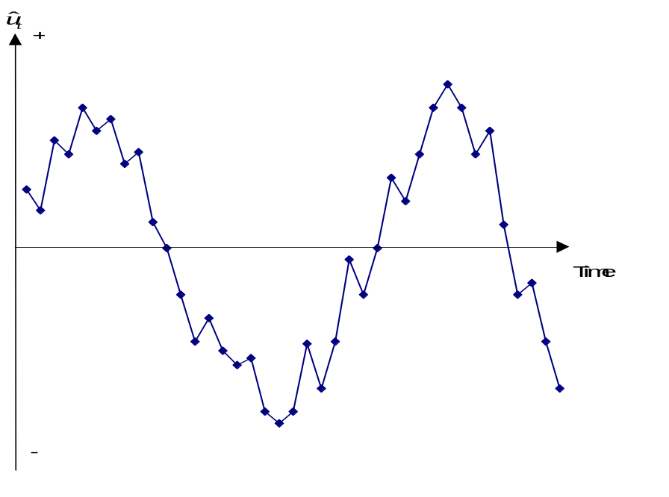
Positive Autocorrelation
Positive Autocorrelation is indicated by a cyclical residual plot over time.
‘Introductory Econometrics for Finance’ © Chris Brooks 2019

Slide 17
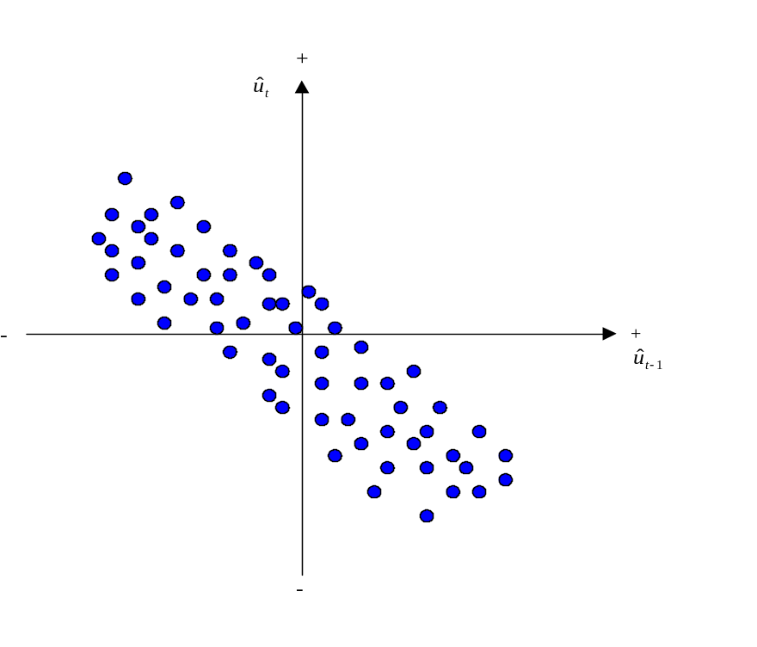
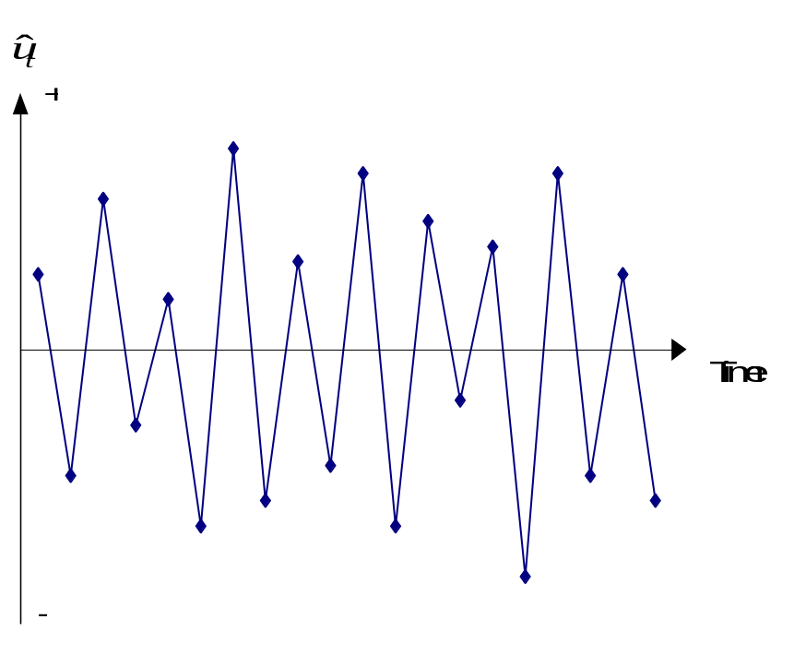
Negative Autocorrelation
Negative autocorrelation is indicated by an alternating pattern where the residuals
cross the time axis more frequently than if they were distributed randomly
‘Introductory Econometrics for Finance’ © Chris Brooks 2019

Slide 18
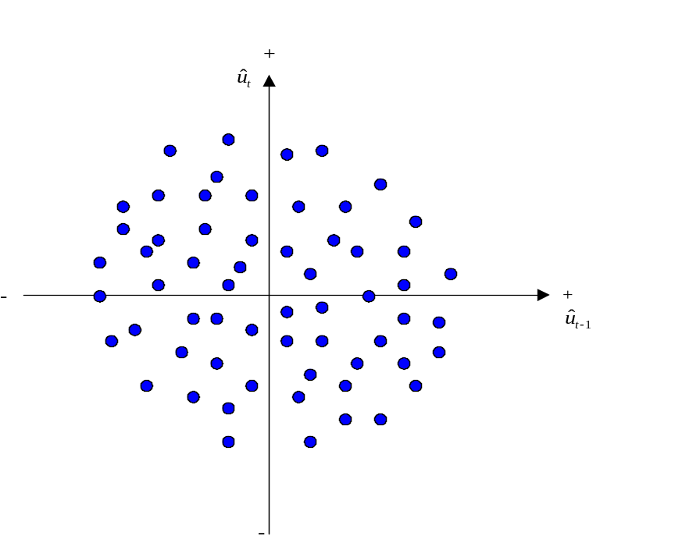
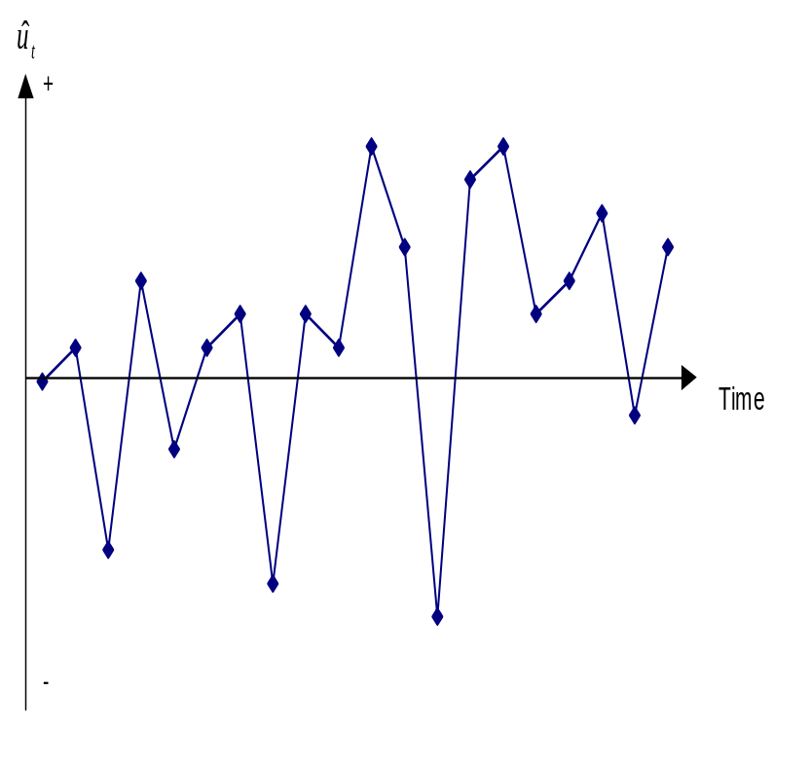
No pattern in residuals –
No autocorrelation
No pattern in residuals at all: this is what we would like to see
‘Introductory Econometrics for Finance’ © Chris Brooks 2019
Notes:
Introductory Econometrics for Finance
Copyright 2002, Chris Brooks

Slide 19
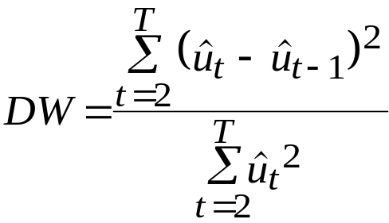
Detecting Autocorrelation:
The Durbin-Watson Test
The Durbin-Watson (DW) is a test for first order autocorrelation - i.e. it assumes that the relationship is between an error and the previous one
u_{t} = ρu_{t-1} + v_{t} (1)
where v_{t} ∼ N(0, σ_{v}²).
The DW test statistic actually tests
H₀ : ρ=0 and H₁ : ρ≠0
The test statistic is calculated by
‘Introductory Econometrics for Finance’ © Chris Brooks 2019
Notes:
Introductory Econometrics for Finance
Copyright 2002, Chris Brooks

Slide 20



The Durbin-Watson Test:
Critical Values
We can also write
(2)
where is the estimated correlation coefficient. Since is a correlation, it implies that .
Rearranging for DW from (2) would give 0≤DW≤4.
If = 0, DW = 2. So roughly speaking, do not reject the null hypothesis if DW is near 2 → i.e. there is little evidence of autocorrelation
Unfortunately, DW has 2 critical values, an upper critical value (d_{u}) and a lower critical value (d_{L}), and there is also an intermediate region where we can neither reject nor not reject H₀.
‘Introductory Econometrics for Finance’ © Chris Brooks 2019
Notes:
Introductory Econometrics for Finance
Copyright 2002, Chris Brooks

Slide 21
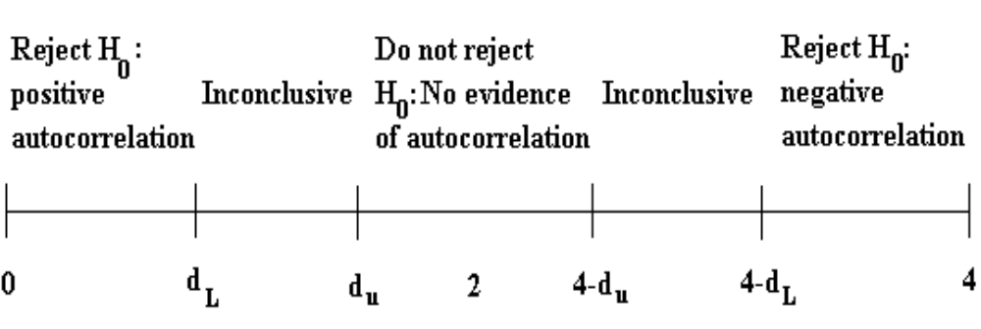
The Durbin-Watson Test: Interpreting the Results
Conditions which Must be Fulfilled for DW to be a Valid Test
1. Constant term in regression
2. Regressors are non-stochastic
3. No lags of dependent variable
‘Introductory Econometrics for Finance’ © Chris Brooks 2019
Notes:
Introductory Econometrics for Finance
Copyright 2002, Chris Brooks

Slide 22



Another Test for Autocorrelation:
The Breusch-Godfrey Test
It is a more general test for r^{th} order autocorrelation:
∼N(0, )
The null and alternative hypotheses are:
H₀ : ρ₁ = 0 and ρ₂ = 0 and ... and ρ_{r} = 0
H₁ : ρ₁ ≠ 0 or ρ₂ ≠ 0 or ... or ρ_{r} ≠ 0
The test is carried out as follows:
1. Estimate the linear regression using OLS and obtain the residuals, .
2. Regress on all of the regressors from stage 1 (the x’s) plus
Obtain R² from this regression.
3. It can be shown that (T-r)R² ∼ χ²(r)
If the test statistic exceeds the critical value from the statistical tables, reject the null hypothesis of no autocorrelation.
‘Introductory Econometrics for Finance’ © Chris Brooks 2019
Notes:
Introductory Econometrics for Finance
Copyright 2002, Chris Brooks

Slide 23
Consequences of Ignoring Autocorrelation if it is Present
The coefficient estimates derived using OLS are still unbiased, but they are inefficient, i.e. they are not BLUE, even in large sample sizes.
Thus, if the standard error estimates are inappropriate, there exists the possibility that we could make the wrong inferences.
R² is likely to be inflated relative to its “correct” value for positively correlated residuals.
‘Introductory Econometrics for Finance’ © Chris Brooks 2019
Notes:
Introductory Econometrics for Finance
Copyright 2002, Chris Brooks

Slide 24
“Remedies” for Autocorrelation
If the form of the autocorrelation is known, we could use a GLS procedure – i.e. an approach that allows for autocorrelated residuals e.g., Cochrane-Orcutt.
But such procedures that “correct” for autocorrelation require assumptions about the form of the autocorrelation.
If these assumptions are invalid, the cure would be more dangerous than the disease! - see Hendry and Mizon (1978).
However, it is unlikely to be the case that the form of the autocorrelation is known, and a more “modern” view is that residual autocorrelation presents an opportunity to modify the regression.
‘Introductory Econometrics for Finance’ © Chris Brooks 2019
Notes:
Introductory Econometrics for Finance
Copyright 2002, Chris Brooks

Slide 25
Dynamic Models
All of the models we have considered so far have been static, e.g.
y_{t} = β₁ + β₂x_{2t} + ... + β_{k}x_{kt} + u_{t}
But we can easily extend this analysis to the case where the current value of y_{t} depends on previous values of y or one of the x’s, e.g.
y_{t} = β₁ + β₂x_{2t} + ... + β_{k}x_{kt} + γ₁y_{t-1} + γ₂x_{2t-1} + … + γ_{k}x_{kt-1}+ u_{t}
We could extend the model even further by adding extra lags, e.g.
x_{2t-2} , y_{t-3} .
‘Introductory Econometrics for Finance’ © Chris Brooks 2019
Notes:
Introductory Econometrics for Finance
Copyright 2002, Chris Brooks

Slide 26
Why Might we Want/Need To Include Lags in a Regression?
Inertia of the dependent variable
Over-reactions
Measuring time series as overlapping moving averages
However, other problems with the regression could cause the null hypothesis of no autocorrelation to be rejected:
  Omission of relevant variables, which are themselves autocorrelated.
  If we have committed a “misspecification” error by using an inappropriate functional form.
  Autocorrelation resulting from unparameterised seasonality.
‘Introductory Econometrics for Finance’ © Chris Brooks 2019
Notes:
Introductory Econometrics for Finance
Copyright 2002, Chris Brooks

Slide 27
Models in First Difference Form
Another way to sometimes deal with the problem of autocorrelation is to switch to a model in first differences.
Denote the first difference of y_{t}, i.e. y_{t} - y_{t-1} as Δy_{t}; similarly for the x-variables, Δx_{2t} = x_{2t} - x_{2t-1} etc.
The model would now be
Δy_{t} = β₁ + β₂ Δx_{2t} + ... + β_{k}Δx_{kt} + u_{t}
Sometimes the change in y is purported to depend on previous values of y or x_{t} as well as changes in x:
Δy_{t} = β₁ + β₂ Δx_{2t} + β₃x_{2t-1} +β₄y_{t-1} + u_{t}
‘Introductory Econometrics for Finance’ © Chris Brooks 2019
Notes:
Introductory Econometrics for Finance
Copyright 2002, Chris Brooks

Slide 28
The Long Run Static Equilibrium Solution
One interesting property of a dynamic model is its long run or static equilibrium solution.
“Equilibrium” implies that the variables have reached some steady state and are no longer changing, i.e. if y and x are in equilibrium, we can say
y_{t} = y_{t+1} = ... =y and x_{t} = x_{t+1} = ... =x
Consequently, Δy_{t} = y_{t} - y_{t-1} = y - y = 0 etc.
So the way to obtain a long run static solution is:
1. Remove all time subscripts from variables
2. Set error terms equal to their expected values, E(u_{t})=0
3. Remove first difference terms altogether
4. Gather terms in x together and gather terms in y together.
These steps can be undertaken in any order
‘Introductory Econometrics for Finance’ © Chris Brooks 2019
Notes:
Introductory Econometrics for Finance
Copyright 2002, Chris Brooks

Slide 29
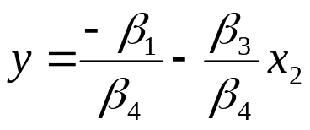
The Long Run Static Equilibrium Solution:
An Example
If our model is
Δy_{t} = β₁ + β₂ Δx_{2t} + β₃x_{2t-1} +β₄y_{t-1} + u_{t}
then the static solution would be given by
0 = β₁ + β₃x_{2t-1} +β₄y_{t-1}
β₄y_{t-1} = - β₁ - β₃x_{2t-1}
‘Introductory Econometrics for Finance’ © Chris Brooks 2019
Notes:
Introductory Econometrics for Finance
Copyright 2002, Chris Brooks

Slide 30
Problems with Adding Lagged Regressors to “Cure” Autocorrelation
Inclusion of lagged values of the dependent variable violates the assumption that the RHS variables are non-stochastic.
What does an equation with a large number of lags actually mean?
Note that if there is still autocorrelation in the residuals of a model including lags, then the OLS estimators will not even be consistent.
‘Introductory Econometrics for Finance’ © Chris Brooks 2019
Notes:
Introductory Econometrics for Finance
Copyright 2002, Chris Brooks

Slide 31
Multicollinearity
This problem occurs when the explanatory variables are very highly correlated with each other.
Perfect multicollinearity
Cannot estimate all the coefficients
- e.g. suppose x₃ = 2x₂
and the model is y_{t} = β₁ + β₂x_{2t} + β₃x_{3t} + β₄x_{4t} + u_{t}
Problems if Near Multicollinearity is Present but Ignored
- R² will be high but the individual coefficients will have high standard errors.
- The regression becomes very sensitive to small changes in the specification.
- Thus confidence intervals for the parameters will be very wide, and significance tests might therefore give inappropriate conclusions.
‘Introductory Econometrics for Finance’ © Chris Brooks 2019
Notes:
Introductory Econometrics for Finance
Copyright 2002, Chris Brooks

Slide 32
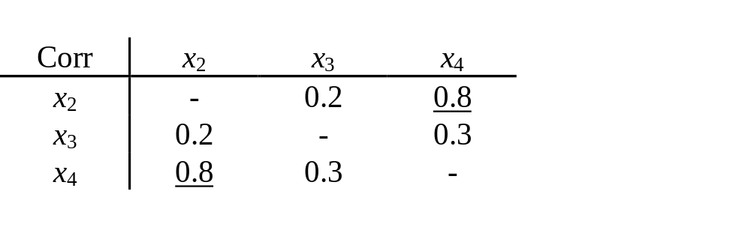
Measuring Multicollinearity
The easiest way to measure the extent of multicollinearity is simply to look at the matrix of correlations between the individual variables. e.g.
But another problem: if 3 or more variables are linear
- e.g. x_{2t} + x_{3t} = x_{4t}
Note that high correlation between y and one of the x’s is not muticollinearity.
‘Introductory Econometrics for Finance’ © Chris Brooks 2019
Notes:
Introductory Econometrics for Finance
Copyright 2002, Chris Brooks

Slide 33
Solutions to the Problem of Multicollinearity
“Traditional” approaches, such as ridge regression or principal components. But these usually bring more problems than they solve.
Some econometricians argue that if the model is otherwise OK, just ignore it
The easiest ways to “cure” the problems are
- drop one of the collinear variables
- transform the highly correlated variables into a ratio
- go out and collect more data e.g.
- a longer run of data
- switch to a higher frequency
‘Introductory Econometrics for Finance’ © Chris Brooks 2019
Notes:
Introductory Econometrics for Finance
Copyright 2002, Chris Brooks

Slide 34




Adopting the Wrong Functional Form
We have previously assumed that the appropriate functional form is linear.
This may not always be true.
We can formally test this using Ramsey’s RESET test, which is a general test for mis-specification of functional form.
Essentially the method works by adding higher order terms of the fitted values (e.g. etc.) into an auxiliary regression:
Regress on powers of the fitted values:
Obtain R² from this regression. The test statistic is given by TR² and is distributed as a .
So if the value of the test statistic is greater than a then reject the null hypothesis that the functional form was correct.
‘Introductory Econometrics for Finance’ © Chris Brooks 2019
Notes:
Introductory Econometrics for Finance
Copyright 2002, Chris Brooks

Slide 35


But what do we do if this is the case?
The RESET test gives us no guide as to what a better specification might be.
One possible cause of rejection of the test is if the true model is
In this case the remedy is obvious.
Another possibility is to transform the data into logarithms. This will linearise many previously multiplicative models into additive ones:
‘Introductory Econometrics for Finance’ © Chris Brooks 2019
Notes:
Introductory Econometrics for Finance
Copyright 2002, Chris Brooks

Slide 36
Testing the Normality Assumption
Why did we need to assume normality for hypothesis testing?
Testing for Departures from Normality
The Bera-Jarque normality test
A normal distribution is not skewed and is defined to have a coefficient of kurtosis of 3.
The kurtosis of the normal distribution is 3 so its excess kurtosis (b₂-3) is zero.
Skewness and kurtosis are the (standardised) third and fourth moments of a distribution.
‘Introductory Econometrics for Finance’ © Chris Brooks 2019
Notes:
Introductory Econometrics for Finance
Copyright 2002, Chris Brooks

Slide 37
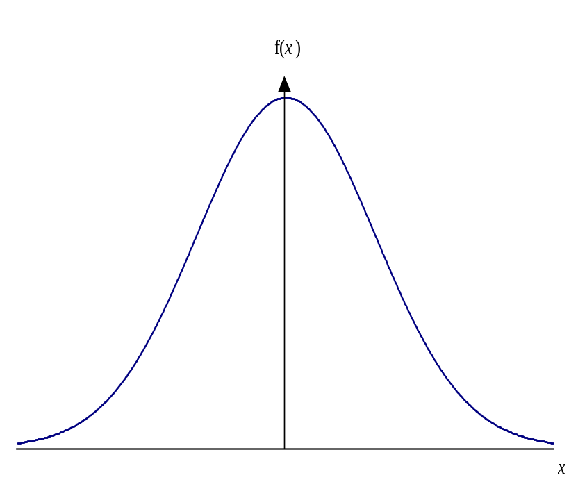
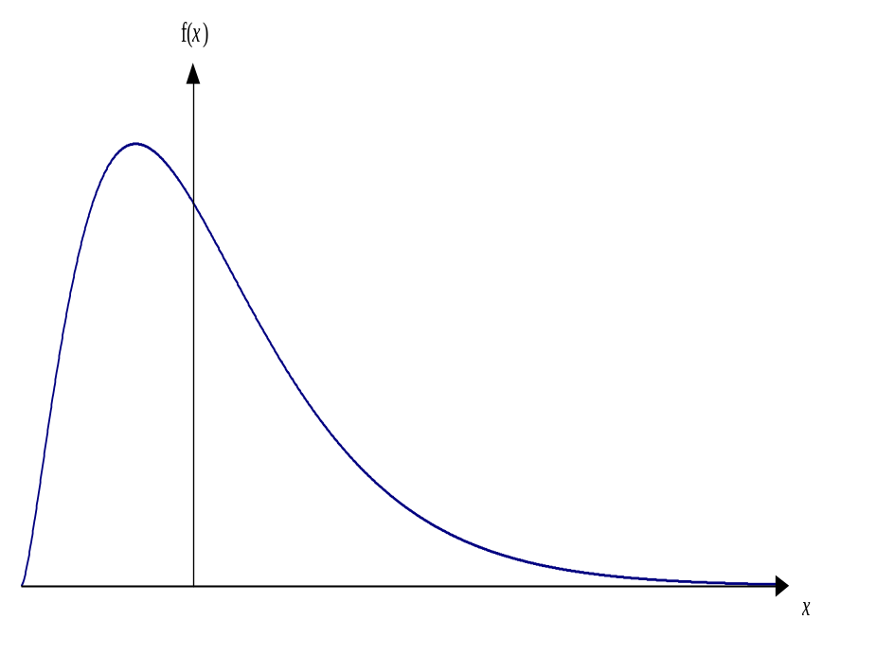
Normal versus Skewed Distributions
A normal distribution A skewed distribution
‘Introductory Econometrics for Finance’ © Chris Brooks 2019
Notes:
Introductory Econometrics for Finance
Copyright 2002, Chris Brooks

Slide 38
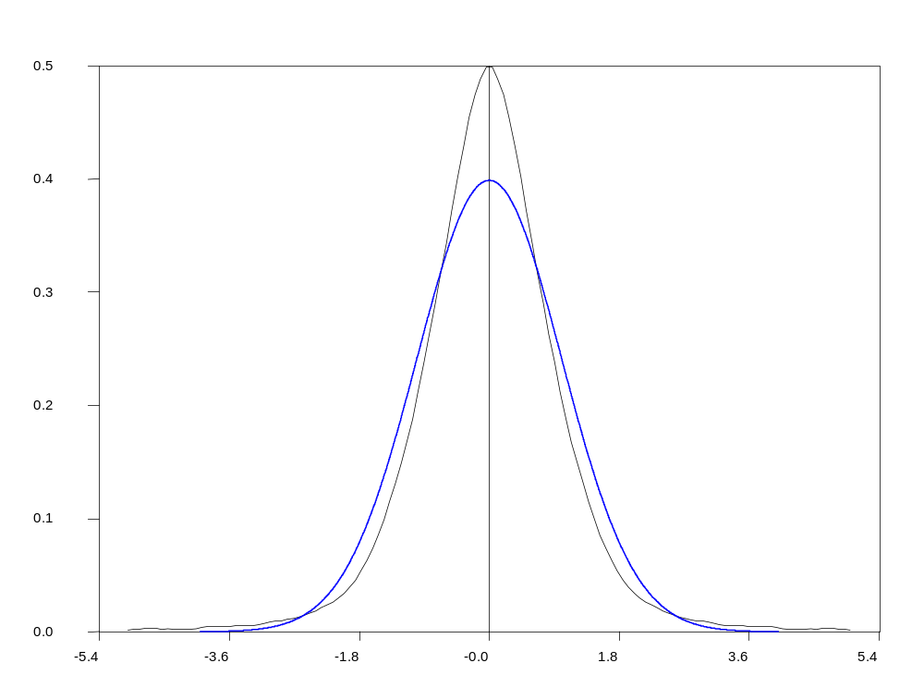
Leptokurtic versus Normal Distribution
‘Introductory Econometrics for Finance’ © Chris Brooks 2019
Notes:
Introductory Econometrics for Finance
Copyright 2002, Chris Brooks

Slide 39
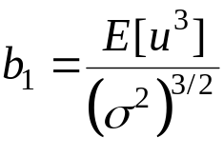
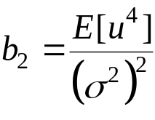
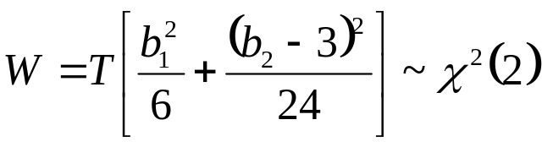
Testing for Normality
Bera and Jarque formalise this by testing the residuals for normality by testing whether the coefficient of skewness and the coefficient of excess kurtosis are jointly zero.
It can be proved that the coefficients of skewness and kurtosis can be expressed respectively as:
and
The Bera-Jarque test statistic is given by
We estimate b₁ and b₂ using the residuals from the OLS regression, .
‘Introductory Econometrics for Finance’ © Chris Brooks 2019
Notes:
Introductory Econometrics for Finance
Copyright 2002, Chris Brooks

Slide 40
What do we do if we find evidence of Non-Normality?
It is not obvious what we should do!
Could use a method which does not assume normality, but difficult and what are its properties?
Often the case that one or two very extreme residuals causes us to reject the normality assumption.
An alternative is to use dummy variables.
e.g. say we estimate a monthly model of asset returns from 1980-1990, and we plot the residuals, and find a particularly large outlier for October 1987:
‘Introductory Econometrics for Finance’ © Chris Brooks 2019
Notes:
Introductory Econometrics for Finance
Copyright 2002, Chris Brooks

Slide 41
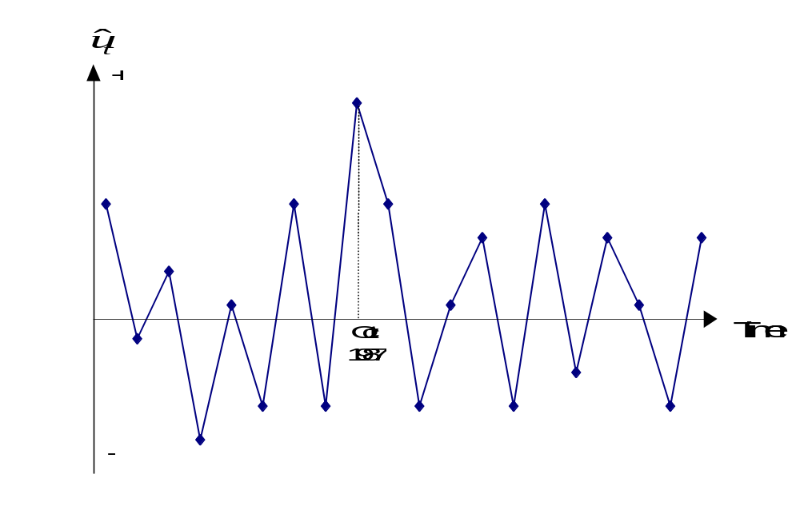
What do we do if we find evidence of Non-Normality? (cont’d)
Create a new variable:
D87M10_{t} = 1 during October 1987 and zero otherwise.
This effectively knocks out that observation. But we need a theoretical reason for adding dummy variables.
‘Introductory Econometrics for Finance’ © Chris Brooks 2019
Notes:
Introductory Econometrics for Finance
Copyright 2002, Chris Brooks

Slide 42
Omission of an Important Variable or
Inclusion of an Irrelevant Variable
Omission of an Important Variable
Consequence: The estimated coefficients on all the other variables will be biased and inconsistent unless the excluded variable is uncorrelated with all the included variables.
Even if this condition is satisfied, the estimate of the coefficient on the constant term will be biased.
The standard errors will also be biased.
Inclusion of an Irrelevant Variable
Coefficient estimates will still be consistent and unbiased, but the estimators will be inefficient.
‘Introductory Econometrics for Finance’ © Chris Brooks 2019

Slide 43
Parameter Stability Tests
So far, we have estimated regressions such as
We have implicitly assumed that the parameters (β₁, β₂ and β₃) are constant for the entire sample period.
We can test this implicit assumption using parameter stability tests. The idea is essentially to split the data into sub-periods and then to estimate up to three models, for each of the sub-parts and for all the data and then to “compare” the RSS of the models.
There are two types of test we can look at:
- Chow test (analysis of variance test)
- Predictive failure tests
‘Introductory Econometrics for Finance’ © Chris Brooks 2019
Notes:
Introductory Econometrics for Finance
Copyright 2002, Chris Brooks

Slide 44
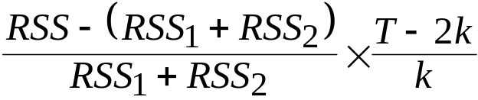
The Chow Test
The steps involved are:
1. Split the data into two sub-periods. Estimate the regression over the whole period and then for the two sub-periods separately (3 regressions). Obtain the RSS for each regression.
2. The restricted regression is now the regression for the whole period while the “unrestricted regression” comes in two parts: for each of the sub-samples.
We can thus form an F-test which is the difference between the RSS’s.
The statistic is
‘Introductory Econometrics for Finance’ © Chris Brooks 2019
Notes:
Introductory Econometrics for Finance
Copyright 2002, Chris Brooks

Slide 45
The Chow Test (cont’d)
where:
RSS = RSS for whole sample
RSS₁ = RSS for sub-sample 1
RSS₂ = RSS for sub-sample 2
T = number of observations
2k = number of regressors in the “unrestricted” regression (since it comes in two parts)
k = number of regressors in (each part of the) “unrestricted” regression
3. Perform the test. If the value of the test statistic is greater than the critical value from the F-distribution, which is an F(k, T-2k), then reject the null hypothesis that the parameters are stable over time.
‘Introductory Econometrics for Finance’ © Chris Brooks 2019
Notes:
Introductory Econometrics for Finance
Copyright 2002, Chris Brooks

Slide 46
A Chow Test Example
Consider the following regression for the CAPM β (again) for the returns on Glaxo.
Say that we are interested in estimating Beta for monthly data from 1981-1992. The model for each sub-period is
1981M1 - 1987M10
0.24 + 1.2R_{Mt} T = 82 RSS₁ = 0.03555
1987M11 - 1992M12
0.68 + 1.53R_{Mt} T = 62 RSS₂ = 0.00336
1981M1 - 1992M12
0.39 + 1.37R_{Mt} T = 144 RSS = 0.0434
‘Introductory Econometrics for Finance’ © Chris Brooks 2019
Notes:
Introductory Econometrics for Finance
Copyright 2002, Chris Brooks

Slide 47

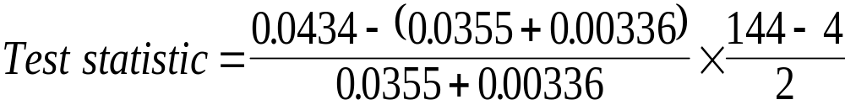
A Chow Test Example - Results
The null hypothesis is
The unrestricted model is the model where this restriction is not imposed
= 7.698
Compare with 5% F(2,140) = 3.06
We reject H₀ at the 5% level and say that we reject the restriction that the coefficients are the same in the two periods.
‘Introductory Econometrics for Finance’ © Chris Brooks 2019
Notes:
Introductory Econometrics for Finance
Copyright 2002, Chris Brooks

Slide 48
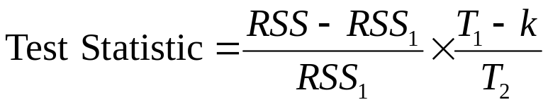
The Predictive Failure Test
Problem with the Chow test is that we need to have enough data to do the
regression on both sub-samples, i.e. T₁>>k, T₂>>k.
An alternative formulation is the predictive failure test.
What we do with the predictive failure test is estimate the regression over a “long” sub-period (i.e. most of the data) and then we predict values for the other period and compare the two.
To calculate the test:
- Run the regression for the whole period (the restricted regression) and obtain the RSS
- Run the regression for the “large” sub-period and obtain the RSS (called RSS₁). Note
we call the number of observations T₁ (even though it may come second).
where T₂ = number of observations we are attempting to “predict”. The test statistic
will follow an F(T₂, T₁-k).
‘Introductory Econometrics for Finance’ © Chris Brooks 2019
Notes:
Introductory Econometrics for Finance
Copyright 2002, Chris Brooks

Slide 49
Backwards versus Forwards Predictive Failure Tests
There are 2 types of predictive failure tests:
- Forward predictive failure tests, where we keep the last few observations back for forecast testing, e.g. we have observations for 1970Q1-1994Q4. So estimate the model over 1970Q1-1993Q4 and forecast 1994Q1-1994Q4.
- Backward predictive failure tests, where we attempt to “back-cast” the first few observations, e.g. if we have data for 1970Q1-1994Q4, and we estimate the model over 1971Q1-1994Q4 and backcast 1970Q1-1970Q4.
‘Introductory Econometrics for Finance’ © Chris Brooks 2019
Notes:
Introductory Econometrics for Finance
Copyright 2002, Chris Brooks

Slide 50
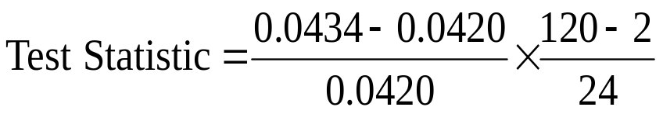
Predictive Failure Tests – An Example
We have the following models estimated:
For the CAPM β on Glaxo.
1980M1-1991M12
0.39 + 1.37R_{Mt} T = 144 RSS = 0.0434
1980M1-1989M12
0.32 + 1.31R_{Mt} T₁ = 120 RSS₁ = 0.0420
Can this regression adequately “forecast” the values for the last two years?
= 0.164
Compare with F(24,118) = 1.66.
So we do not reject the null hypothesis that the model can adequately predict the last few observations.
‘Introductory Econometrics for Finance’ © Chris Brooks 2019
Notes:
Introductory Econometrics for Finance
Copyright 2002, Chris Brooks

Slide 51
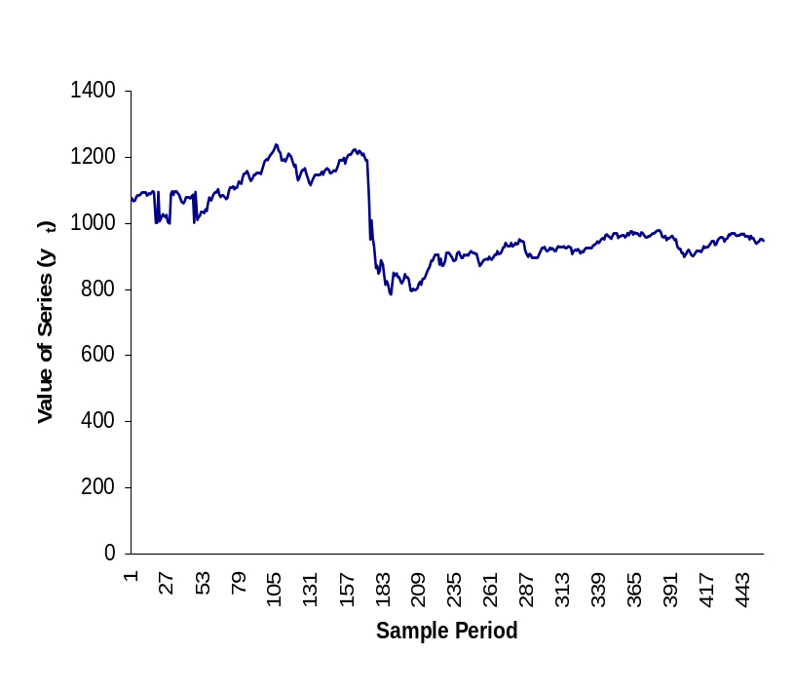
How do we decide the sub-parts to use?
As a rule of thumb, we could use all or some of the following:
- Plot the dependent variable over time and split the data accordingly to any
obvious structural changes in the series, e.g.
- Split the data according to any known important
historical events (e.g. stock market crash, new government elected)
- Use all but the last few observations and do a predictive failure test on those.
‘Introductory Econometrics for Finance’ © Chris Brooks 2019
Notes:
Introductory Econometrics for Finance
Copyright 2002, Chris Brooks

Slide 52
Measurement Errors
If there is measurement error in one or more of the explanatory variables, this will violate the assumption that the explanatory variables are non-stochastic
Sometimes this is also known as the errors-in-variables problem
Measurement errors can occur in a variety of circumstances, e.g.
  Macroeconomic variables are almost always estimated quantities (GDP, inflation, and so on), as is most information contained in company accounts
  Sometimes we cannot observe or obtain data on a variable we require and so we need to use a proxy variable – for instance, many models include expected quantities (e.g., expected inflation) but we cannot typically measure expectations.
‘Introductory Econometrics for Finance’ © Chris Brooks 2019
Notes:
Introductory Econometrics for Finance
Copyright 2002, Chris Brooks

Slide 53
Measurement Error in the Explanatory Variable(s)
Suppose that we wish to estimate a model containing just one explanatory variable, x_{t}:
y_{t} = β₁ + β₂x_{t} + u_{t},
where u_{t} is a disturbance term
Suppose further that x_{t} is measured with error so that instead of observing its true value, we observe a noisy version, , that comprises the actual x_{t} plus some additional noise, v_{t} that is independent of x_{t} and u_{t}:
Taking the first equation and substituting in for x_{t} from the second:
We can rewrite this equation by separately expressing the composite error term, (u_{t} − β₂v_{t})
‘Introductory Econometrics for Finance’ © Chris Brooks 2019
Notes:
Introductory Econometrics for Finance
Copyright 2002, Chris Brooks

Slide 54
Measurement Error in the Explanatory Variable(s)
It should be clear from this equation and the one for the explanatory variable measured with error, and the composite error term,
(u_{t} − β₂v_{t}), are correlated since both depend on v_{t}
Thus the requirement that the explanatory variables are non-stochastic does not hold
This causes the parameters to be estimated inconsistently
The size of the bias in the estimates will be a function of the variance of the noise in x_{t} as a proportion of the overall disturbance variance
If β₂ is positive, the bias will be negative but if β₂ is negative, the bias will be positive
So the parameter estimate will always be biased towards zero as a result of the measurement noise.
‘Introductory Econometrics for Finance’ © Chris Brooks 2019

Slide 55
Measurement Error and Tests of the CAPM
The standard approach to testing the CAPM pioneered by Fama and MacBeth (1973) comprises two stages
Since the betas are estimated at the first stage rather than being directly observable, they will surely contain measurement error
The effect of this has sometimes been termed attenuation bias.
Tests of the CAPM showed that the relationship between beta and returns was smaller than expected, and this is precisely what would happen as a result of measurement error
Various approaches to solving this issue have been proposed, the most common of which is to use portfolio betas in place of individual betas
An alternative approach (Shanken,1992) is to modify the standard errors in the second stage regression to adjust directly for the measurement errors.
‘Introductory Econometrics for Finance’ © Chris Brooks 2019

Slide 56
Measurement Error in the Explained Variable
Measurement error in the explained variable is much less serious than in the explanatory variable(s)
This is one of the motivations for the inclusion of the disturbance term in a regression model
When the explained variable is measured with error, the disturbance term will in effect be a composite of the usual disturbance term and another source of noise from the measurement error
Then the parameter estimates will still be consistent and unbiased and the usual formulae for calculating standard errors will still be appropriate
The only consequence is that the additional noise means that the standard errors will be enlarged relative to the situation where there was no measurement error in y.
‘Introductory Econometrics for Finance’ © Chris Brooks 2019
Notes:
Introductory Econometrics for Finance
Copyright 2002, Chris Brooks

Slide 57
A Strategy for Building Econometric Models
Our Objective:
To build a statistically adequate empirical model which
- satisfies the assumptions of the CLRM
- is parsimonious
- has the appropriate theoretical interpretation
- has the right “shape” - i.e.
- all signs on coefficients are “correct”
- all sizes of coefficients are “correct”
- is capable of explaining the results of all competing models
‘Introductory Econometrics for Finance’ © Chris Brooks 2019
Notes:
Introductory Econometrics for Finance
Copyright 2002, Chris Brooks

Slide 58
2 Approaches to Building Econometric Models
There are 2 popular philosophies of building econometric models: the “specific-to-general” and “general-to-specific” approaches.
“Specific-to-general” was used almost universally until the mid 1980’s, and involved starting with the simplest model and gradually adding to it.
Little, if any, diagnostic testing was undertaken. But this meant that all inferences were potentially invalid.
An alternative and more modern approach to model building is the “LSE” or Hendry “general-to-specific” methodology.
The advantages of this approach are that it is statistically sensible and also the theory on which the models are based usually has nothing to say about the lag structure of a model.
‘Introductory Econometrics for Finance’ © Chris Brooks 2019
Notes:
Introductory Econometrics for Finance
Copyright 2002, Chris Brooks

Slide 59
The General-to-Specific Approach
First step is to form a “large” model with lots of variables on the right hand side
This is known as a GUM (generalised unrestricted model)
At this stage, we want to make sure that the model satisfies all of the assumptions of the CLRM
If the assumptions are violated, we need to take appropriate actions to remedy this, e.g.
- taking logs
- adding lags
- dummy variables
We need to do this before testing hypotheses
Once we have a model which satisfies the assumptions, it could be very big with lots of lags & independent variables
‘Introductory Econometrics for Finance’ © Chris Brooks 2019
Notes:
Introductory Econometrics for Finance
Copyright 2002, Chris Brooks

Slide 60
The General-to-Specific Approach:
Reparameterising the Model
The next stage is to reparameterise the model by
- knocking out very insignificant regressors
- some coefficients may be insignificantly different from each other,
so we can combine them.
At each stage, we need to check the assumptions are still OK.
Hopefully at this stage, we have a statistically adequate empirical model which we can use for
- testing underlying financial theories
- forecasting future values of the dependent variable
- formulating policies, etc.
‘Introductory Econometrics for Finance’ © Chris Brooks 2019
Notes:
Introductory Econometrics for Finance
Copyright 2002, Chris Brooks

Slide 61
Regression Analysis In Practice - A Further Example:
Determinants of Sovereign Credit Ratings
Cantor and Packer (1996)
Financial background:
What are sovereign credit ratings and why are we interested in them?
Two ratings agencies (Moody’s and Standard and Poor’s) provide credit ratings for many governments.
Each possible rating is denoted by a grading:
  Moody’s Standard and Poor’s
  Aaa AAA
  …… …..
  B3 B-
‘Introductory Econometrics for Finance’ © Chris Brooks 2019

Slide 62
Purposes of the Paper
- to attempt to explain and model how the ratings agencies arrived at
their ratings.
- to use the same factors to explain the spreads of sovereign yields
above a risk-free proxy
- to determine what factors affect how the sovereign yields react to
ratings announcements
‘Introductory Econometrics for Finance’ © Chris Brooks 2019
Notes:
Introductory Econometrics for Finance
Copyright 2002, Chris Brooks

Slide 63
Determinants of Sovereign Ratings
Data
Quantifying the ratings (dependent variable): Aaa/AAA=16, ... , B3/B-=1
Explanatory variables (units of measurement):
- Per capita income in 1994 (thousands of dollars)
- Average annual GDP growth 1991-1994 (%)
- Average annual inflation 1992-1994 (%)
- Fiscal balance: Average annual government budget surplus as a
proportion of GDP 1992-1994 (%)
- External balance: Average annual current account surplus as a proportion
of GDP 1992-1994 (%)
- External debt foreign currency debt as a proportion of exports 1994 (%)
- Dummy for economic development
- Dummy for default history
Income and inflation are transformed to their logarithms.
‘Introductory Econometrics for Finance’ © Chris Brooks 2019
Notes:
Introductory Econometrics for Finance
Copyright 2002, Chris Brooks

Slide 64
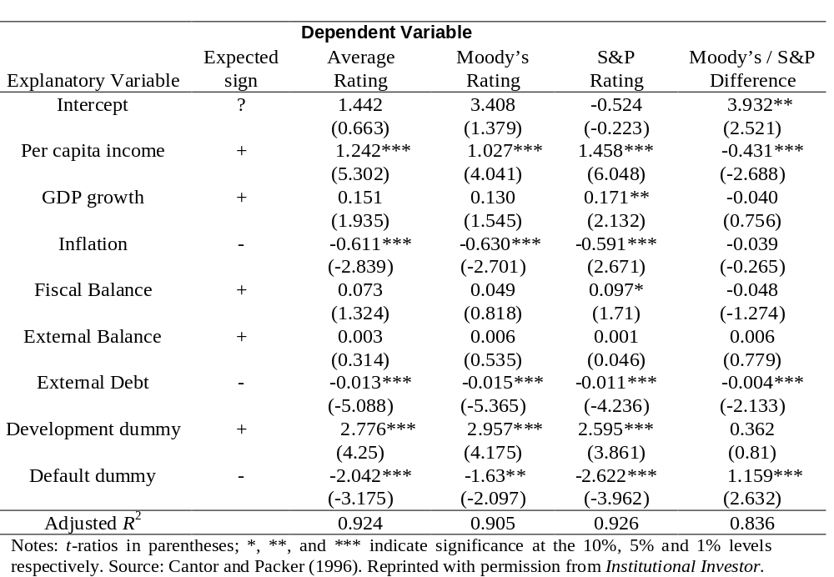
The model: Linear and estimated using OLS
‘Introductory Econometrics for Finance’ © Chris Brooks 2019
Notes:
Introductory Econometrics for Finance
Copyright 2002, Chris Brooks

Slide 65
Interpreting the Model
From a statistical perspective
Virtually no diagnostics
Adjusted R² is high
Look at the residuals: actual rating - fitted rating
From a financial perspective
Do the coefficients have their expected signs and sizes?
Do Ratings Add to Publicly Available Available Information?
Now dependent variable is
- Log (Yield on the sovereign bond - yield on a US treasury bond)
‘Introductory Econometrics for Finance’ © Chris Brooks 2019
Notes:
Introductory Econometrics for Finance
Copyright 2002, Chris Brooks

Slide 66
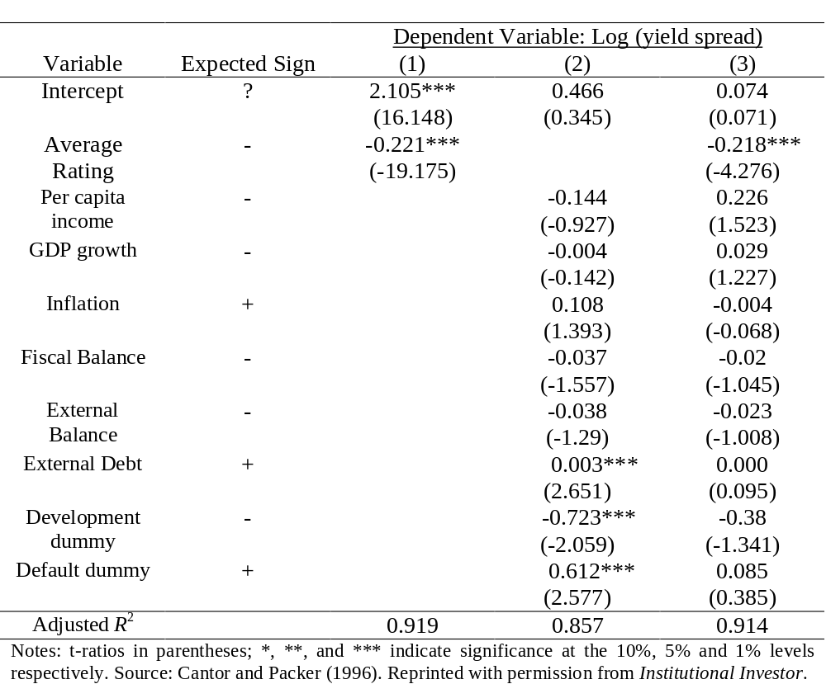
Do Ratings Add to Publicly Available Available Information? Results
‘Introductory Econometrics for Finance’ © Chris Brooks 2019
Notes:
Introductory Econometrics for Finance
Copyright 2002, Chris Brooks

Slide 67
What Determines How the Market Reacts to Ratings Announcements?
The sample: Every announcement of a ratings change that occurred between 1987 and 1994 - 79 such announcements spread over 18 countries.
39 were actual ratings changes
40 were “watchlist / outlook” changes
The dependent variable: changes in the relative spreads over the US T-bond over a 2-day period at the time of the announcement.
‘Introductory Econometrics for Finance’ © Chris Brooks 2019
Notes:
Introductory Econometrics for Finance
Copyright 2002, Chris Brooks

Slide 68
What Determines How the Market Reacts to Ratings Announcements? Explanatory variables.
0 /1 dummies for
- Whether the announcement was positive
- Whether there was an actual ratings change
- Whether the bond was speculative grade
- Whether there had been another ratings announcement in the previous 60 days.
and
- The change in the spread over the previous 60 days.
- The ratings gap between the announcing and the other agency
‘Introductory Econometrics for Finance’ © Chris Brooks 2019
Notes:
Introductory Econometrics for Finance
Copyright 2002, Chris Brooks

Slide 69
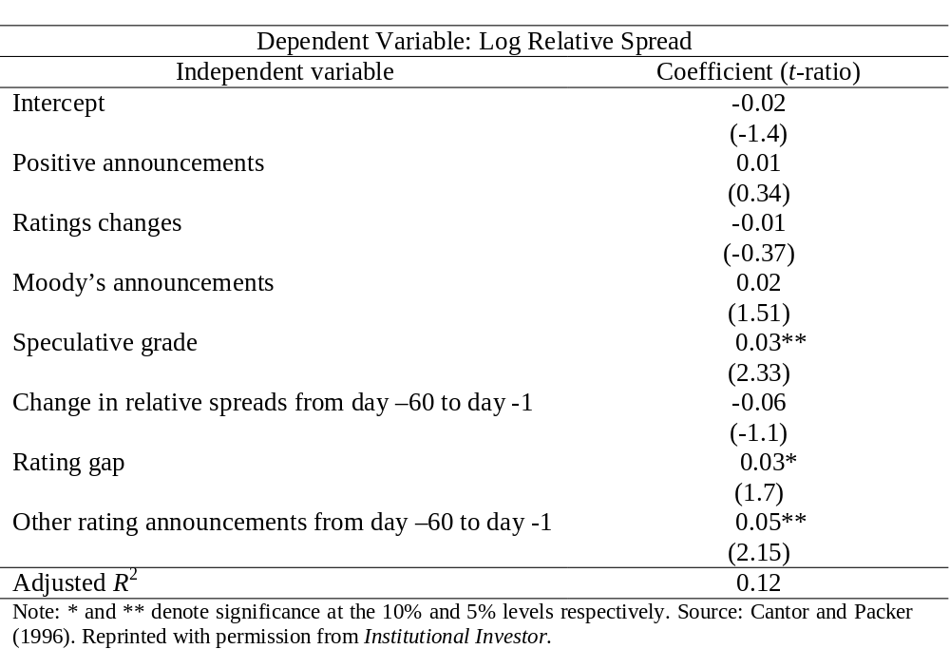
What Determines How the Market Reacts to Ratings Announcements? Results
‘Introductory Econometrics for Finance’ © Chris Brooks 2019

Slide 70
Conclusions
6 factors appear to play a big role in determining sovereign credit ratings - incomes, GDP growth, inflation, external debt, industrialised or not, and default history.
The ratings provide more information on yields than all of the macro factors put together.
We cannot determine well what factors influence how the markets will react to ratings announcements.
‘Introductory Econometrics for Finance’ © Chris Brooks 2019
Notes:
Introductory Econometrics for Finance
Copyright 2002, Chris Brooks

Slide 71
Comments on the Paper
Only 49 observations for first set of regressions and 35 for yield regressions and up to 10 regressors
No attempt at reparameterisation
Little attempt at diagnostic checking
Where did the factors (explanatory variables) come from?
‘Introductory Econometrics for Finance’ © Chris Brooks 2019

